Slide 1

WEB APPLICATION DEVELOPMENT
MongoDB
Prof.Kiran P
Department of
Computer Science and Engineering

Slide 2

MongoDB
NoSQL Database
Stands for Not Only SQL??
Class of non-relational data storage systems
Usually do not require a fixed table schema nor do they use the concept of joins to derive data from different tables

Slide 3
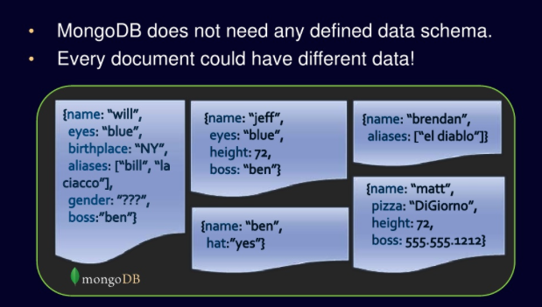
MongoDB
MongoDB – a NoSQL Database
No Defined Schema (Schema Free or Schema Less)

Slide 4
MongoDB
Terms Mapping (DB vs. MongoDB)
RDBMS | MongoDB
Database | Database
Table | Collection
Tuple/Row | Document
Column | Field
Table Join | Embedded Documents
Primary Key | Primary Key (Default _id key provided by mongodb)

Slide 5
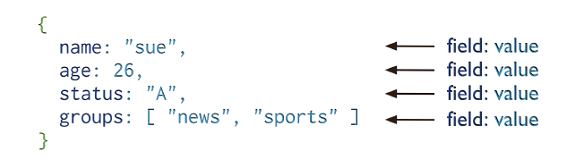
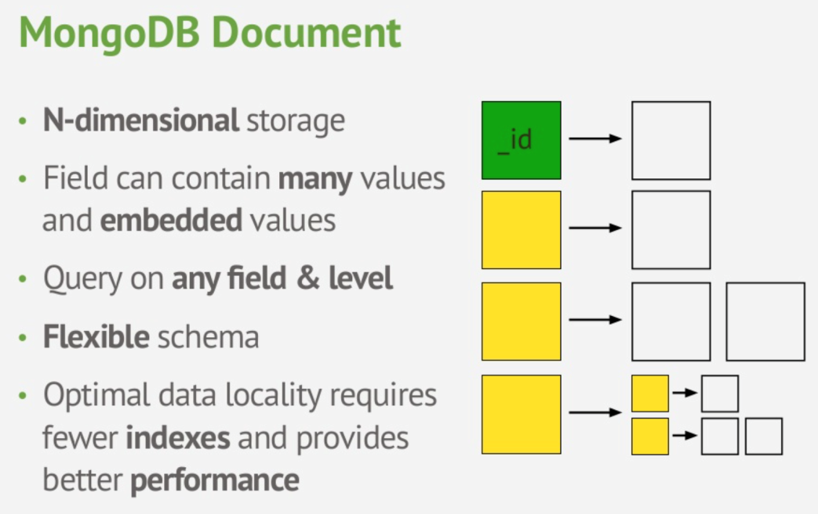
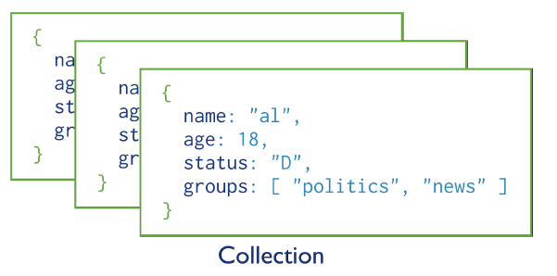
MongoDB
MongoDB Data Model
One document (e.g., one tuple in RDBMS)
Collection is a group of similar documents
Within a collection, each document must have a unique Id
One Collection (e.g., one Table in RDBMS)

Slide 6
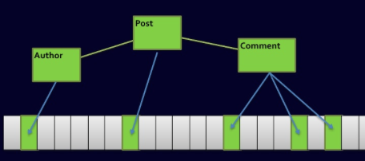
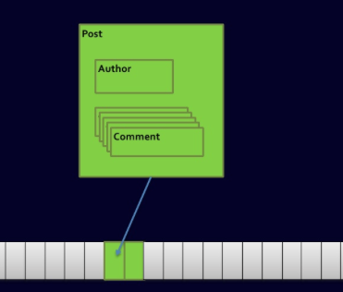
MongoDB
Complex Join Queries
Relational DBs
MongoDB

Slide 7



MongoDB
Getting Started…
Install it
Practice simple stuff
Move to complex stuff
Install it from here: http://www.mongodb.org
Manual: http://docs.mongodb.org/master/MongoDB-manual.pdf
(Focus on Ch. 3, 4 for now)
Dataset: http://docs.mongodb.org/manual/reference/bios-example-collection/

Slide 8
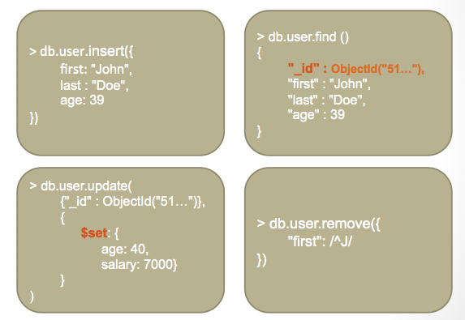
MongoDB
Data Operations
Create
db.collection.insert( <document> ) (insertOne,insertMany)
db.collection.save( <document> )
db.collection.update( <query>, <update>, { upsert: true } )
Read
db.collection.find( <query>, <projection> )
db.collection.findOne( <query>, <projection> )
Update
db.collection.update( <query>, <update>, <options> )
// updateOne, updateMany
Delete
db.collection.deleteOne( <query>, <justOne> )
db.collection.deleteMany( <query>, <justOne> )

Slide 9
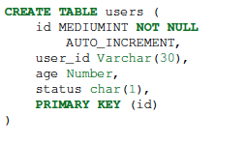


MongoDB
Example Operations – Creation and Deletion
In RDBMS
In MongoDB
Either insert the 1st docuement
Or create “Users” collection explicitly

Slide 10
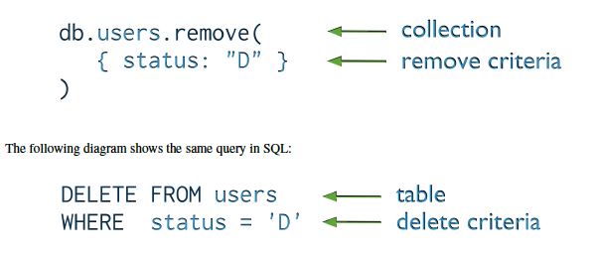
MongoDB
Example Operations – Removal or Deletion
You can put condition on any field in the document (even _id)
db.users.remove ( )
Removes all documents from users collection

Slide 11
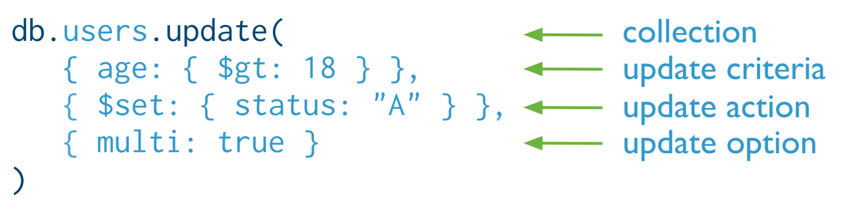

MongoDB
Example Operations – Update
Otherwise, it will update only the 1st matching document
Equivalent to this statement in SQL:

Slide 12
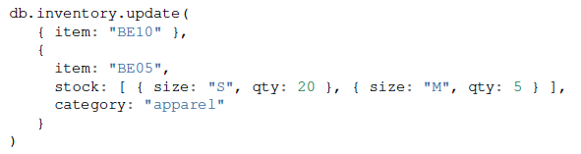
MongoDB
Example Operations – Replace a document
Query Condition
New
doc
For the document having item = “BE10”, replace it with the given document

Slide 13
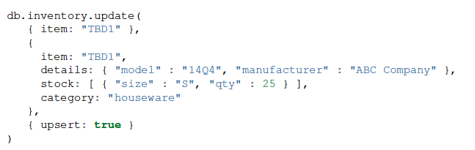
MongoDB
Example Operations – Insert or Update?
The upsert option
If the document having item = “TBD1” is in the DB, it will be replaced
Otherwise, it will be inserted.

Slide 14
THANK YOU
Prof.Kiran P
Department of
Computer Science and Engineering
kiranp@pes.edu

